Slide 1
Introduction to Data Science Data Mining for Business Analytics
Brian d’Alessandro
VP – Data Science, Dstillery
Adjunct Professor, NYU
Fall 2014
Fine Print: these slides are, and always will be a work in progress. The material presented herein is original, inspired, or borrowed from others’ worl. Where possible, attribution and acknowledgement will be made to content’s original source. Do not distribute, except for as needed as a pedagogical tool in the subject of Data Science.
Notes:
https://www.youtube.com/watch?v=aMDe5pODkB0 (harlan harris)

Slide 2
Course fundamentals

Slide 3

Instructor
Bio
Education:
Undergrad: Rutgers, Math
Grad: NYU Stern, Statistics
Professional Experience
Dstillery (AdTech)
Meetup.com (Social Web)
American Express (Credit/Risk)
TV Guide (Marketing)
Affiliations/Publications
ACM KDD
Big Data Journal
Machine Learning Journal
SIAM
Brian d’Alessandro
Notes:
Add brief bio

Slide 4

Ta Elizabeth lamm
Office hours:
Mondays 2:00-4:00 PM at the CDS space
(726 Broadway, 7th Floor), or by appointment.
Bio:
Elizabeth Lamm is a second year MS Data Science student at NYU Courant Institute of Mathematical Science. Following undergraduate studies in mathematics and computer science, she worked in retirement and financial consulting. She cleaned and validated large, complex data sets and used them to forecast employee demographic and retirement plan financial information for clients. In her first year as an MS student, Elizabeth did research at NYU Langone Medical Center using eye tracking data to identify and monitor brain injuries.
Notes:
Add brief bio

Slide 5
Goals of this course
Understand what a Data Scientist is
Notes:
Add brief bio

Slide 6
Goals of this course
Understand what a Data Scientist is
Approach applicable problems data-analytically
Notes:
Add brief bio

Slide 7
Goals of this course
Understand what a Data Scientist is
Approach applicable problems data-analytically
Have hands-on experience mining data
Notes:
Add brief bio

Slide 8


Programming!
In order to succeed and participate in this class,
You will…
Need access to a computer with admin privileges
Have to learn and use the Python programming language.
Please see me after class if this is an issue.
Notes:
Add brief bio

Slide 9
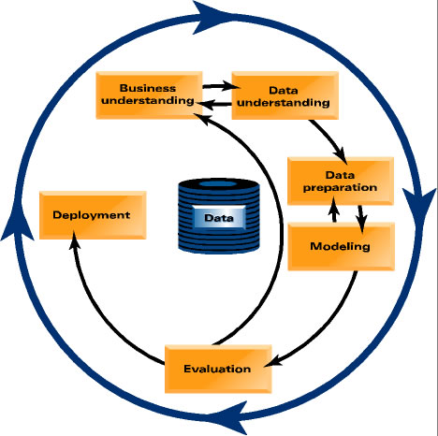
Lecture outline
This course will work in the same flow as a typical data mining project.
We’ll also peel the layers of data mining like an onion, so the flow might not always be linear.
Notes:
Do something more illustrative than a table.

Slide 10
Lecture outline
Series 1 – The Predictive Modeling Process
No | Date | Topics
1 | 17-Sep | Course Intro, What is DS? The DS Environment
2 | 1-Oct | IPython Basics, Data
3 | 8-Oct | Structure in Data
4 | 15-Oct | Linear Models, Fitting Models to Data
5 | 22-Oct | Evaluation, Generalization and Overfitting
Notes:
Do something more illustrative than a table.

Slide 11
Lecture outline
Series 2 – Beyond the Basics
No | Date | Topics
6 | 29-Oct | Unsupervised Learning, Clustering Recommender Systems
7 | 5-Nov | Recommender Systems Cont'd, Text Modline
8 | 12-Nov | Non-Linear Modeling
9 | 19-Nov | Explanatory Data Science, Causality
10 | 3-Dec | "Big" Data Science
11 | 10-Dec | Model Building Systems, Automated Decision Making
12 | 17-Dec | Project Presentations
Notes:
Do something more illustrative than a table.

Slide 12
Office hours
TBD
I’ll take a vote in the first assignment to figure out when people are most available and interested.

Slide 13
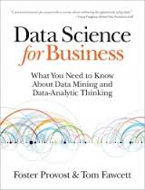
Course materials
Primary Text
We want to emphasize above all else, decision making through analytic thinking.
Notes:
Put photo of books

Slide 14
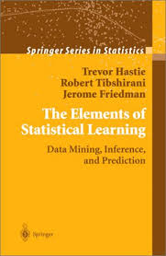
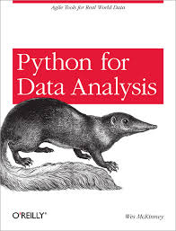
Course materials
Supplementary Text
Nonetheless, you’ll need to learn a lot of technical details:
Notes:
Show photos of stats and pandas

Slide 15
homework
Will be announced the week they’re assigned
We’ll spend time in class discussing what is expected
Are all expected to be performed solo
Discussions are welcome and encouraged on the course forum
Will involve Python analysis with discussion of results
Open questions will be assigned
Code and open answers to be turned in
Notes:
Show photos of stats and pandas

Slide 16
Final project
The final project will pull together all of the elements you learn from this class and will simulate the experience of being an professional data scientist. Ultimately, we want you to be able to identify a problem, implement a solution, and demonstrate the value of your solution.
Milestones (due dates will be assigned)
Choose a team
Pick a dataset and a business problem, write a proposal
Explore and validate the utility of the data
Write a professional report
Present to the class
Notes:
Show photos of stats and pandas

Slide 17
Grading
As per the syllabus…
Note: never underestimate the efficacy of a good pie chart.
Notes:
Show photos of stats and pandas

